Slide 1
Welcome to NFSC 200 Health at Every Size®
Background on the War on Obesity
Introduction to HAES
Overview of Course Topics
Melanie King, MS, RD

Slide 2
Lecture Overview
Background on the War on Obesity
Defining weight and health
Changes in weight over time
Associations between weight and health (A look at the research)
Disadvantages of dieting
Introduction to HAES
Basic principles of HAES
Differences between a non-diet and diet approach
Research behind HAES
Common misconceptions of HAES
Cost of making assumptions
Overview of Course Topics

Slide 3

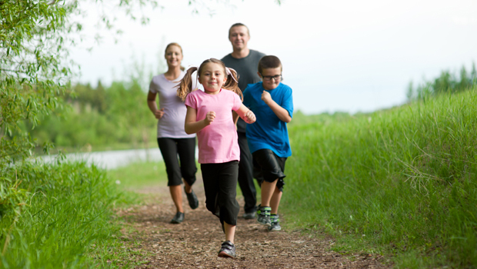
The Challenge:
To open your mind to seeing the entire issue of weight (and weight obsession) differently
So you can create a healthy, joyful life
And
Do no harm.

Slide 4
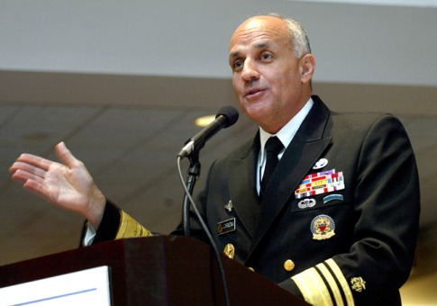
The “War on Obesity”
"Obesity is the terror within," Richard Carmona said during a lecture at the University of South Carolina. "Unless we do something about it, the magnitude of the dilemma will dwarf 9-11 or any other terrorist attempt."
-Richard Carmona (former Surgeon General)

Slide 5
Defining Weight and Health

Slide 6

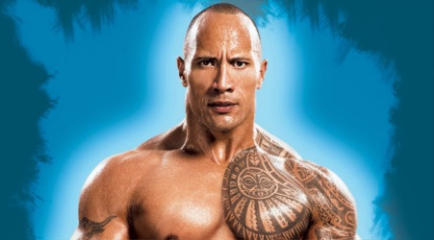
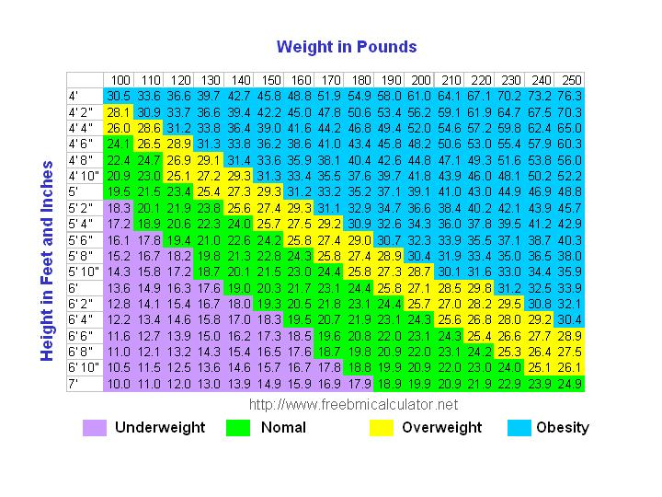
BMI: Body Mass Index
Weight in kg / height in meters squared
Limitations of using BMI to assess health?

Slide 7
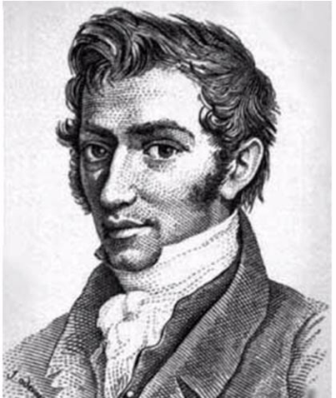
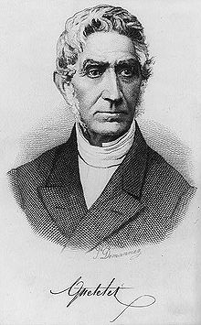
History of the BMI
Invented 1835 by Adolphe Quetelet
Quetelet Index = weight/height²
1985-1998 NIH panel used BMI kg/m²
Men > 27.8 Women > 27.3 are overweight
(85%ile for 20-29 year olds)
1998 the cutoffs were lowered, despite lack of scientific support:
BMI | Weight Status
Below 18.5 | Underweight
18.5 to 24.9 | Healthy/desirable weight
25.0 to 29.9 | Overweight
30.0 to 39.9 | Obese
40 and above | Extremely Obese

Slide 8
Changes in Weight Over Time

Slide 9
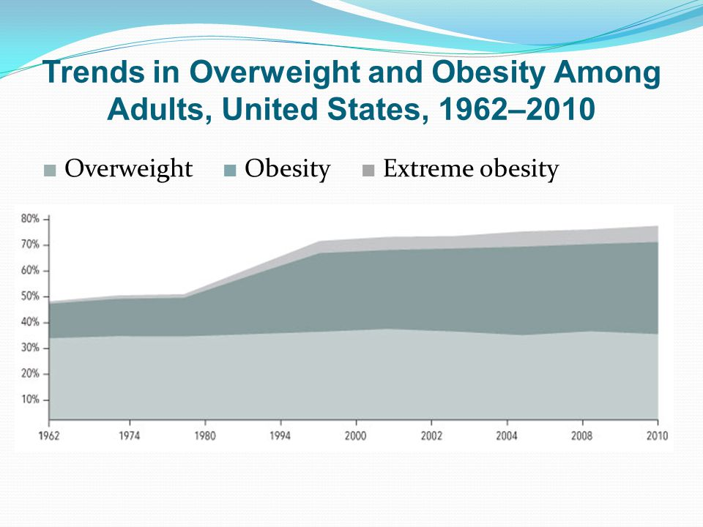
According to the Center for Disease Control, overweight and obesity are on the rise

Slide 10
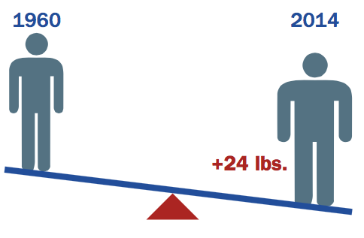
Obesity in America Stabilizing at a High Rate
Adults: From 2005 to 2006 to 2011 to 2012, rates remained the same.
Children: Overall rates have remained the same for the past 10 years.
Some cohorts stable, some rising
Rates have continued to increase among men and boys and Black and Mexican American women.

Slide 11
Why the increase in weight over the last several decades?
Over the past 35 years, obesity rates have more than doubled. Why?
Environment? (Abundant availability of low cost, high calorie foods)
Genetics? (Thrifty gene theory)
Dieting? ($60+ billion diet industry → weight gain)
Environmental pollutents?
Food processing?
Decreased physical activity?

Slide 12
What diets are people following? What diets are people following?
http://www.webmd.com/diet/
http://www.webmd.com/diet/evaluate-latest-diets
Other diets?

Slide 13
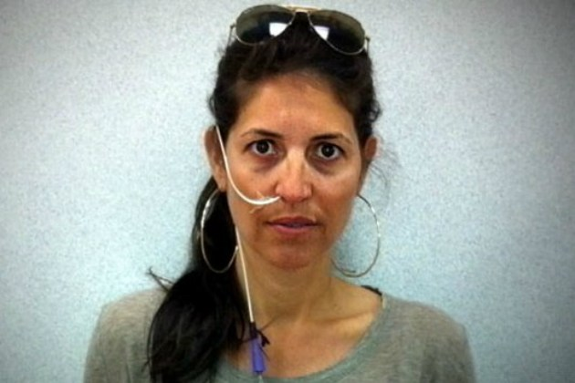
One consequence of the “Fight Obesity” craze:
The K-E Diet
(The Ketogenic Enteral Nutrition Diet)

Slide 14
Associations between Weight and Health
What Does The Research Say?

Slide 15
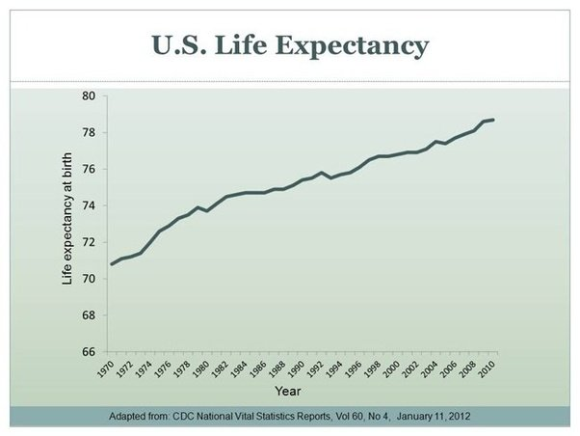
People are living longer

Slide 16
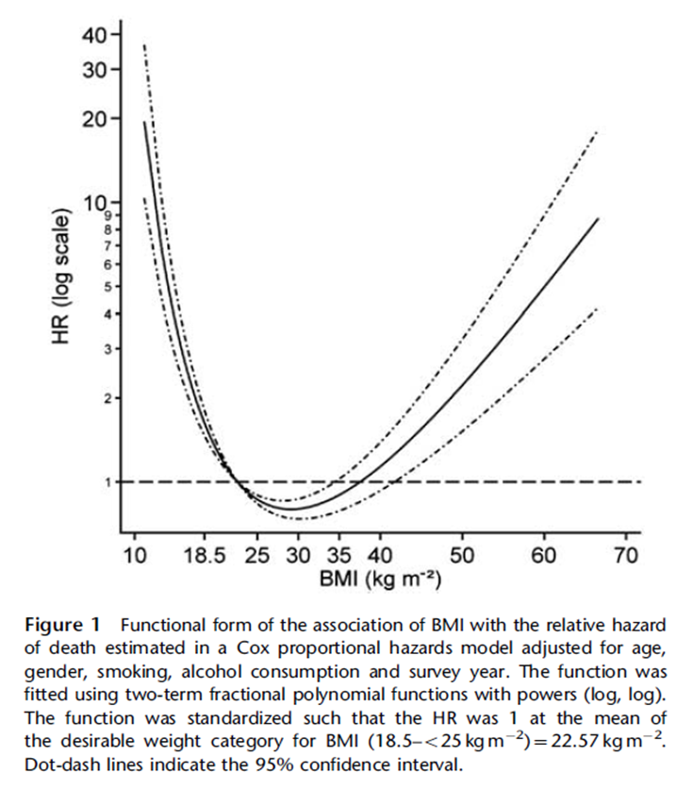
Science on BMI and Death
Inter J of Obesity 35:838-851, 2011
20,000 adults
Reminder:
Under 18.5 underweight
18.5-24.9 desirable weight
25-29.9 overweight
30-39.9 obese
40 and above extremely obese
Adjusted for age, gender, smoking, alcohol consumption… not even controlled for PA!

Slide 17
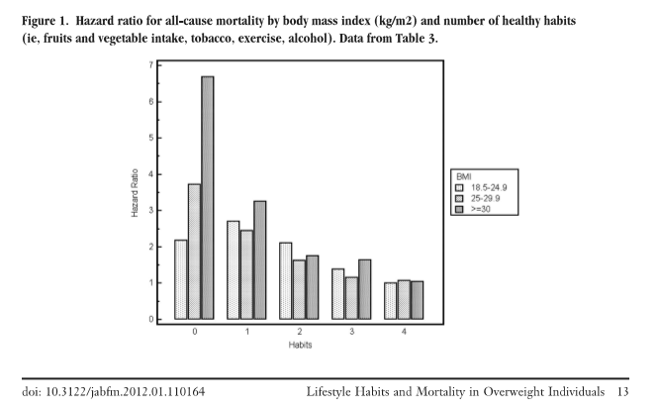
Science on BMI and Death cont.

Slide 18

Body fat exaggerated as an independent health risk?
According to NHANES (National Health and Nutrition Examination Survey) Data:
Lowest mortality in “overweight” category
Moderate “obesity” had same risk as “normal” weight
In other research:
Significantly lower mortality in “overweight” category
Grade 1 obesity not associated with higher mortality
Grades 2 and 3 obesity associated with higher mortality
Flegal, et al., JAMA, 2005, 293:1861
Flegal, et al., JAMA. 2013;309(1):71-82

Slide 19

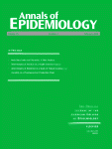
Meta-analysis of data on elderly
“overweight” not associated w/increased risk of all-cause or cause-specific mortality
Only “modest” increase in mortality associated with moderate obesity.
(Jansen, et al., Obes Rev, 2007, 8:41)
Review of the Literature
26 studies examined
“overweight” assoc’d with greater longevity than “normal” weight.
(McGee, Ann of Epid, 15(2), 2005, 87-97)

Slide 20
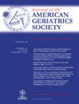
Prospective cohort study:
4,677 men and 4,563 women age 70-75
Mortality lowest in overweight participants
Mortality similar between normal weight and obese subjects.
BUT being sedentary doubled the risk of death for women and increased it by 28% for men.
(Flicker, et al J Am Geriatr Soc. 2010;58(2):234-241)

Slide 21
What About Weight and Risk for Disease?
The risk associated with obesity depends on the disease. For example:
T2 Diabetes: Obesity is strongly related (a risk factor) but is it the cause?
Insulin resistance has a strong genetic component.
Insulin resistance → pancreas secretes more insulin → weight gain →more insulin resistance → weight gain → → → diabetes.

Slide 22
If obesity is the cause of diabetes, shouldn’t weight loss cure it?
Gastric bypass surgery: symptoms improve within days, before significant weight loss has occurred.
Weight loss via diet improves glucose control, but it’s only short term. Research: back to starting values in 6-18 months, even if the weight loss is maintained.
Better way to improve or reverse diabetes:
Changes in nutrition and activity!
EVEN if no weight is lost.
(Bacon, 2008, 135)
Update: for some patients, diabetes returns.

Slide 23
Breast Cancer
Of 26 cohort studies:
Only three showed a significant positive association with overweight/obesity
Two showed a decreased risk for breast cancer in obese subjects.
CDC: There is “little or no association of excess all-cancer mortality with any of the BMI categories.”
“While there are some associations between specific types of cancer and obesity, as well as mechanisms through which fat tissue affects cancer, it is clear that obesity has been greatly… exaggerated as a cancer risk.”

Slide 24
Cardiovascular Disease:
The same stuff: There’s no statistical relationship between BMI or body fat and atherosclerosis.
~~~~
Am I saying there’s no risk associated with weight?
No.
We need to question the information

Slide 25
Overweight vs. Unfit?
Can fitness decrease the risk that comes from fatness?
Physical fitness
Reduces insulin resistance
Improves glycemic control
Improves blood lipids
Can decrease the risk associated with obesity
(More on this in a bit…)

Slide 26
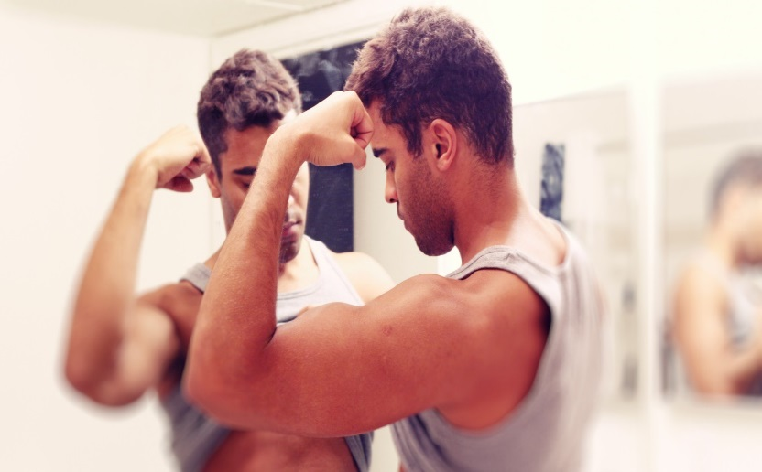
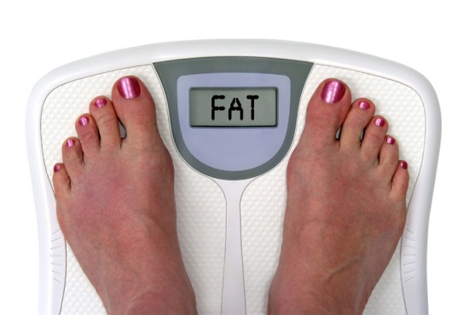
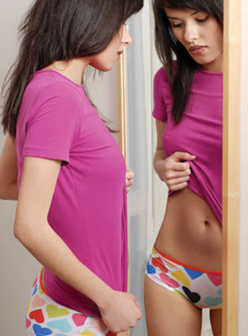
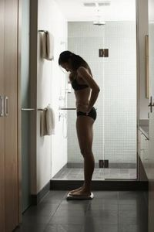
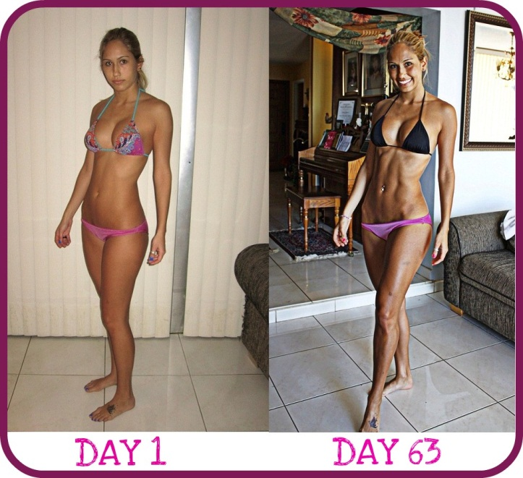
Is health really the reason we are weight obsessed? For health?
Obsession with weight and how it takes over your every move, every thought...

Slide 27
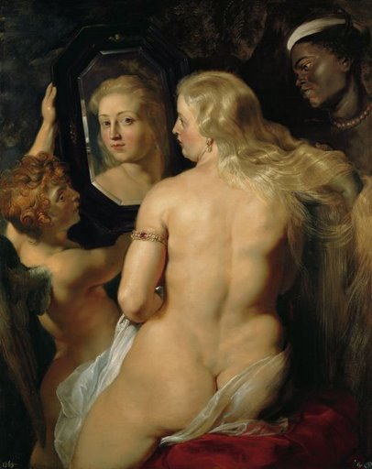
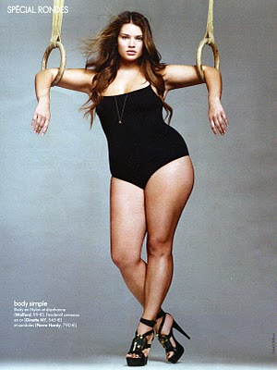
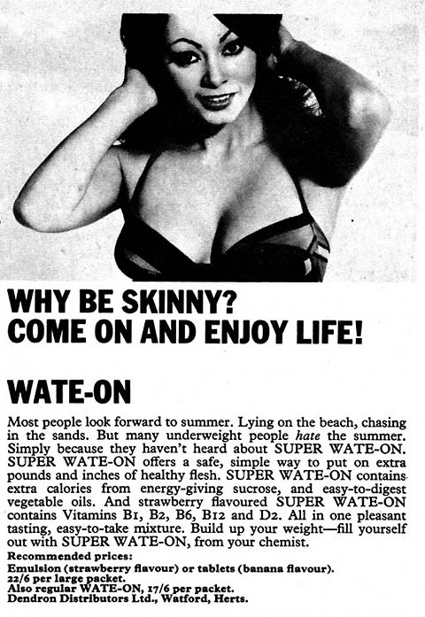
That’s a far cry from:

Slide 28
The Disadvantages of Dieting

Slide 29
Weight-Focused Interventions Lead to…
Weight cycling | (Kruger et al, 2004; Strohacker & McFarlin, 2010)
Increased risk for osteoporosis | (Bacon et al, 2004; Van Loan & Keim, 2000)
Increased chronic psychological stress & coritsol production | (Tomiyama et al, 2010)
Increased anxiety about weight | (Davison et al, 2003; Holms, 2007)
Eating disorder behaviors | (Daníelsdóttir et al, 2007)
Weight gain | (Neumark-Sztainer et al, 2006)
Stigmatization and Discrimination against fat individuals | (Puhl, 2008)

Slide 30
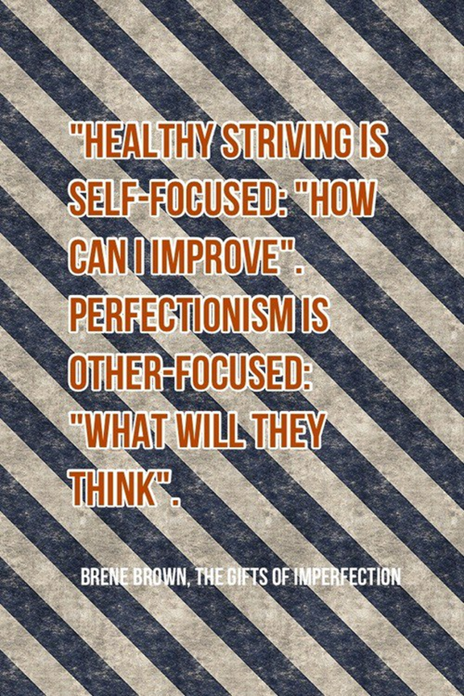

Slide 31
The Stats on Dieting
Nutrisystem, Jenny Craig, Weight Watchers and other diets?
Long-term follow-up studies
Majority regain virtually all of the weight that was lost
Even when they maintain their diet or exercise program! (Mann et al, 2005; Miller, 1999)
Study: 1 in 6 people lost weight and were able to keep off 10% of their body weight for a year.
NIH says: 1/3 to 2/3 of weight is regained within one year and almost all is regained by year 5
1/3 to 2/3 of dieters regain more weight than was lost on their diets (Mann et al, 2005)
Is it ethical to prescribe this? And then blame people when they “fail?”

Slide 32
You HAVE to look for studies that followed their subjects for 5+ years. Please review this article: http://abcnews.go.com/Health/Fitness/story?id=3251242&page=1

Slide 33

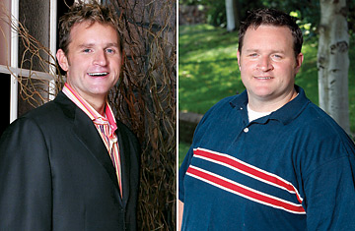
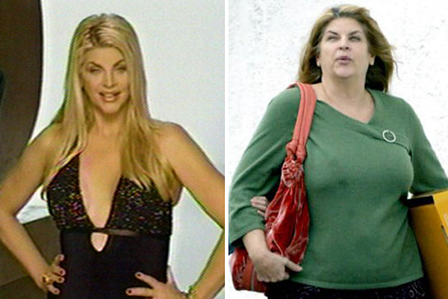

The Danger: The media hold the 5% up as emblematic! And what do they (we) say about the other 95%?

Slide 34


Introduction to HAES

Slide 35
Health at Every Size®
Health At Every Size® Basic Principles
Accepting and respecting the diversity of body shapes and sizes.
Recognizing that health and well-being are multi-dimensional and that they include physical, social, spiritual, occupational, emotional, and intellectual aspects.
Promoting all aspects of health and well-being for people of all sizes.
Promoting eating in a manner which balances individual nutritional needs, hunger, satiety, appetite, and pleasure.
Promoting individually appropriate, enjoyable, life-enhancing physical activity, rather than exercise that is focused on a goal of weight loss.

Slide 36
 | Diet Paradigm | Non-Diet Paradigm
Weight | Achieve ideal weight Aim for 5-10% weight loss | Body will seek its natural weight when individuals eat in response to cues
Hunger | Attempt to suppress or ignore hunger (will power) | Physical cues to eat are valuable and relied upon
Exercise | Exercise to lose weight | Listen to the body, seek play and natural movement- not connected to weight loss
Food | Good/bad, legal/illegal, should/shouldn’t etc. Quantity/quality determined by external source | ALL food is acceptable Quantity/quality are determined by responding to physical cues (hunger/fullness, taste, well-being, blood glucose)
Self Esteem | Self-esteem will improve with weight loss (doesn’t happen though) | Self-esteem will improve with self-determined eating/movement Bodies come in all sizes and are naturally beautiful

Slide 37
Research Behind HAES
6 Randomized Controlled Trials
HAES/non-diet groups experienced improvements in
physiological measures (e.g. blood pressure, blood lipids)
health behaviors (e.g. physical activity, eating disorder pathology)
psychosocial outcomes (e.g, mood, self-esteem, body image)
No studies found adverse findings in the HAES/non-diet groups
Bacon et al, 2002; Bacon et al, 2005; Ciliska, 1998; Goodrick et al, 1998; Mesinger et al, 2009; Miller et al, 1993; Provencher et al, 2007; Provencher et al, 2009; Rapport et al, 2000; Tanco et al, 1998

Slide 38
Research Behind HAES
Randomized Controlled Trial Spotlight
6-month randomized clinical trial
HAES group vs. Diet group
2 year follow-up
White, obese, female chronic dieters 30-45 yrs
N=39 per group to start
Bacon et al, 2002; Bacon et al, 2005

Slide 39
Research Behind HAES
 | Diet Group | Non-Diet
Intervention | Calorie restriction and food diaries Read food labels/fat grams Food Exchanges Exercise- ACSM guidelines | Body acceptance/self-worth Techniques to focus on internal cues vs. external cues Nutrition- effects of food choices on well-being Activity that allowed them to enjoy their bodies
Results Psych | Increased cognitive restraint | Decreased cognitive restraint
Biochemical | No sign changes at 2-year follow-up | Sign changes in Total Chol, LDL, Systolic BP at 2-year follow-up
Drop Out | 41% drop out rate | 8% drop out rate
Weight | Lost weight, then gained | Maintained weight
What surprises you about this study?
Bacon et al, 2002; Bacon et al, 2005

Slide 40
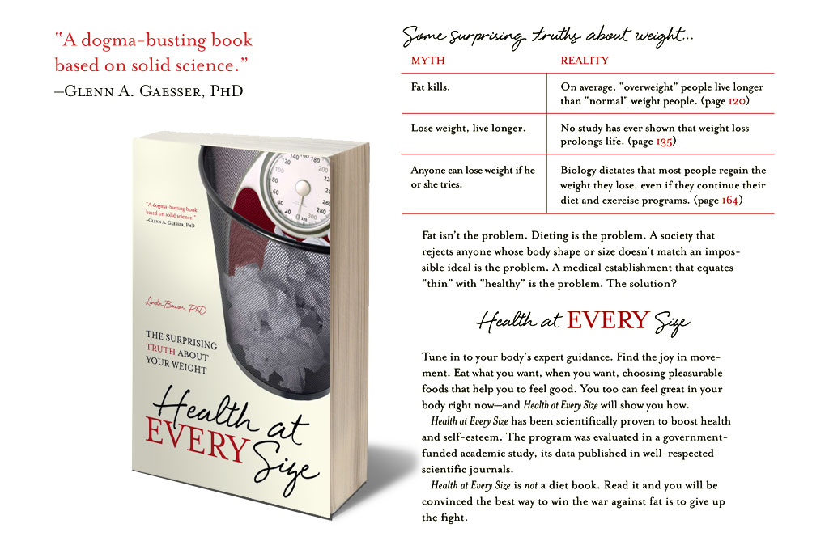
Research Behind HAES

Slide 41
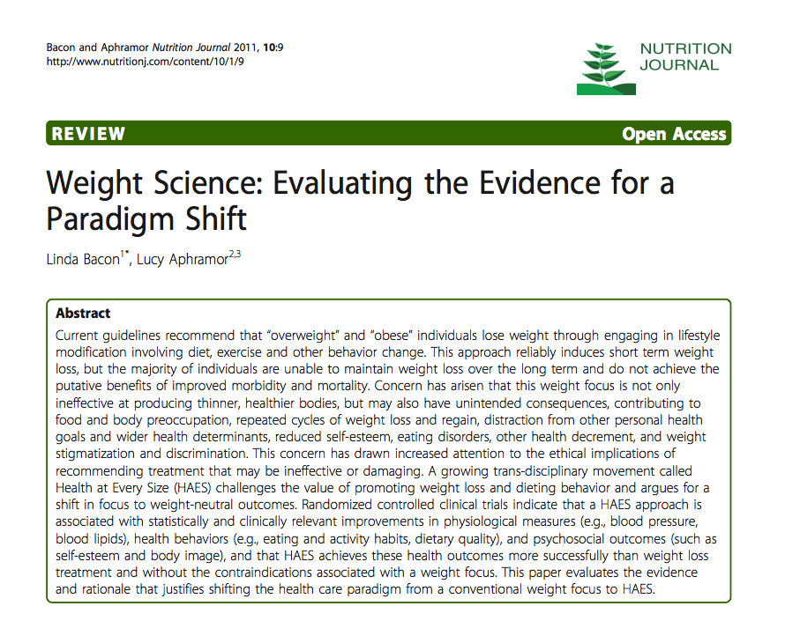
Research Behind HAES

Slide 42
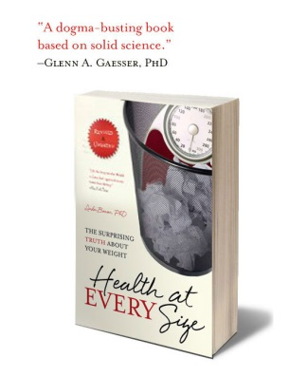
Myth: Fat Kills
BMI only weakly predicts longevity (except at statistical extremes) (Flegal et al, 2005)
People who are overweight or moderately obese live at least as long as normal weight people, and often longer (Flegal et al, 2005; Durazo-Arvizu et al, 1998; Trojano et al, 1996)
National Health and Nutrition Examination Surveys I, II, and III- greatest longevity was in the overweight category (Flegal et al, 2005)
Comprehensive review of the research pooled data for over 350,000 subjects from 26 studies (McGee, 2005)
overweight is associated with greater longevity than normal weight
What are your thoughts on the above statistics?

Slide 43
Myth: Obesity Causes Diseases
Obesity is associated with this, that, and the other thing:
Brainstorm!

Slide 44

Myth: Obesity Causes Diseases
Association vs. causation
Epidemiologic studies don’t control for:
Fitness/activity
Nutrient intake
Socioeconomic status
Body Image (perceived discrimination poses a threat to health) (Williams et al, 2003; Schafer and Ferraro, 2011)
Weight cycling which is associated with (Montani et al, 2006)
Inflammation
Hypertension
Insulin resistance
Hyperlipidemia

Slide 45
Yes, but doesn’t weight loss improve blood pressure, cholesterol, blood sugars, etc?
Short-term weight loss does improve health measures
Do health measures improve because of the weight or the behavior changes that were made?
Liposuction study (Klein et al, 2004) found that after 23 lbs were removed, there were no improvements in
blood pressure
triglycerides
cholesterol
insulin sensitivity

Slide 46
Myth: Weight Loss → Living Longer
Weight loss increases the risk of premature death among obese individuals, even when the weight loss is intentional and studies are well controlled (Simonson et al, 2008; Sørensen et al, 2005)

Slide 47
Myth: There are Effective Weight Loss Interventions
Remember this?
Long-term follow-up studies
Majority regain virtually all of the weight that was lost
Even when they maintain their diet or exercise program! (Mann et al, 2005; Miller, 1999)
NIH says: 1/3 to 2/3 of weight is regained within one year and almost all is regained by year 5
1/3 to 2/3 of dieters regain more weight than was lost on their diets (Mann et al, 2005)

Slide 48
Myth: HAES Promoters are Opposed to Weight Loss
Truth: HAES is a Weight Neutral approach
When you start practicing the HAES tenets, one of three things will happen:
You’ll lose weight
Your weight will stay the same
You’ll gain weight
Focus is not on weight
Focus is on mindful eating, mindful movement, and body acceptance

Slide 49
The Cost of Making Assumptions
Thin = healthy
30% of normal weight men and 20% of normal weight women exhibit cardiometabolic abnormalities
Fat = unhealthy
½ of overweight and 1/3 of obese are cardiometabolically healthy (Wildman 2008)
BMI Profiling →
Normal weight individuals who are not healthy are overlooked
Overweight and obese individuals who are healthy are encouraged to lose weight

Slide 50
The Cost of Fat Bashing
What is fat bashing?
Fat jokes
The War on Obesity
Making assumptions about others based on size (stereotypes)
“Fat people eat too much and don’t exercise enough”
“Overweight people are lazy”
Size Discrimination
Discrimination based upon the size of a person’s body
Refusing to hire or promote someone based on size
Treating individuals with disdain
Ingrained in modern society
Discrimination used to motivate someone to lose weight (does this work?)

Slide 51
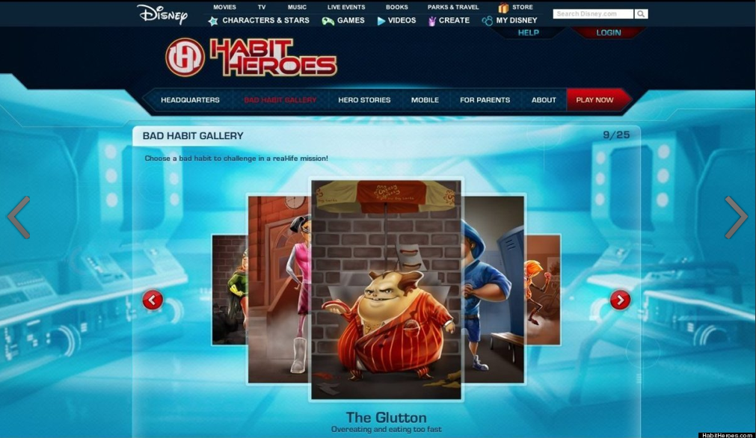

Slide 52
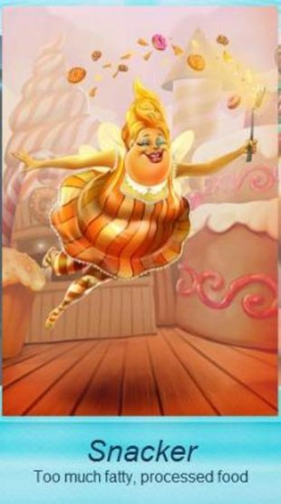
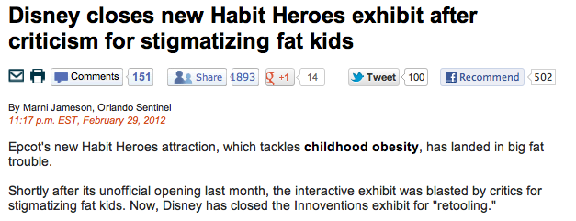

Slide 53
How to embody HAES: We have so much to talk about this semester!!
Focus on health not weight
With positive changes in eating and activity, your health will improve and your body may settle at a weight that is right for you
Ditch the diet
Dieting leads to weight cycling, low self-esteem, and often weight gain and disordered eating
Encourage self acceptance
Our society values thinness, but healthy, beautiful bodies come in all shapes and sizes

Slide 54
How to embody HAES: We have so much to talk about this semester!!
Normalize the act of eating
Bodies generally need to eat every 2-5 hours.
Explore the morality of eating
Thinking of food as good or bad, healthy or unhealthy leads people to feel badly about eating certain foods. Eat and enjoy all types of food, including desserts and treats.
Positive nutrition
Focus on adding in foods (increase variety) not taking away.

Slide 55
How to embody HAES: We have so much to talk about this semester!!
Separate nutrition from weight
“Oh I gained a pound today, I better just have a salad for lunch.”
Separate physical activity from weight
Research shows that individuals who exercise to manage weight are less likely to stick with it long term.
Intuitive Eating and Intuitive Exercise
(Next slide)

Slide 56
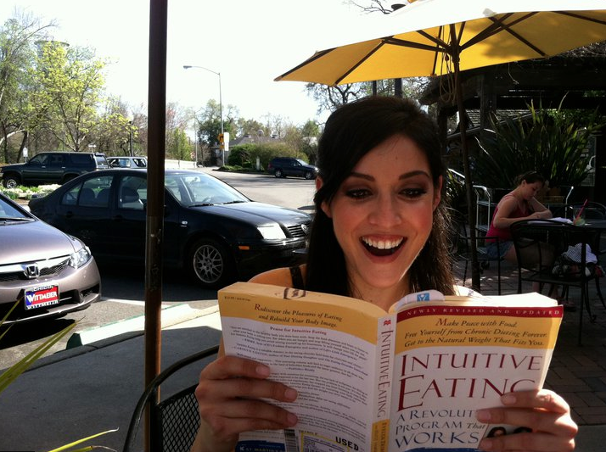
We’ll also be talking about:
Intuitive Eating
Eating in response to hunger, fullness and cravings
Intuitive Exercise
Moving your body in enjoyable ways

Slide 57
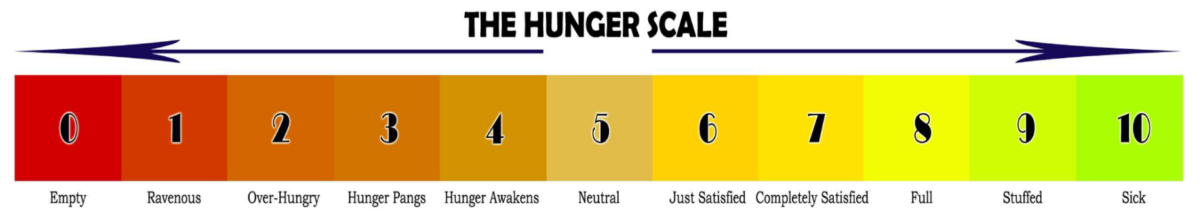
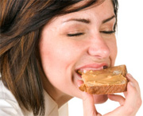
And we’ll talk more about…

Slide 58
How to embody HAES: We have so much to talk about this semester!!
Permission to eat
Restriction leads to deprivation, which often leads to binge, which often leads to guilt, followed by restriction
Pleasure of eating
Take a breath, giver yourself permission to eat and enjoy your food
Mindful eating
Be in the moment while eating with compassion, acceptance, non-judgement. Savor your food, noticing smells, tastes, and textures.

Slide 59
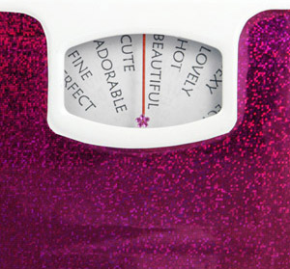
How to embody HAES: We have so much to talk about this semester!!
Body Acceptance is about releasing control
You have control over what and when you eat and exercise but NO control over what happens to your weight
Celebrate your body for what it can do

Slide 60
How to HAES – What were those basic principals, again?
Health At Every Size® Basic Principles
Accepting and respecting the diversity of body shapes and sizes.
Recognizing that health and well-being are multi-dimensional and that they include physical, social, spiritual, occupational, emotional, and intellectual aspects.
Promoting all aspects of health and well-being for people of all sizes.
Promoting eating in a manner which balances individual nutritional needs, hunger, satiety, appetite, and pleasure.
Promoting individually appropriate, enjoyable, life-enhancing physical activity, rather than exercise that is focused on a goal of weight loss.

Slide 61
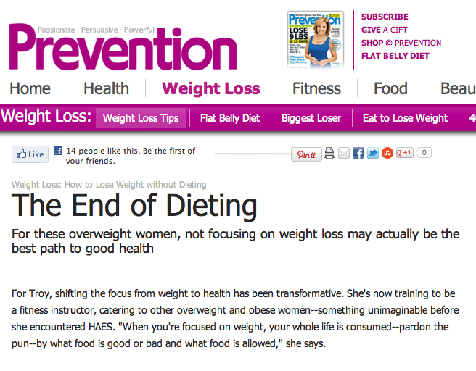
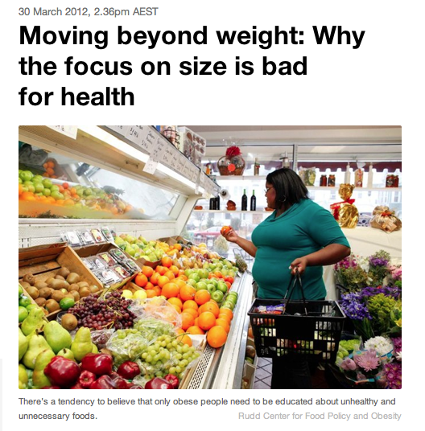

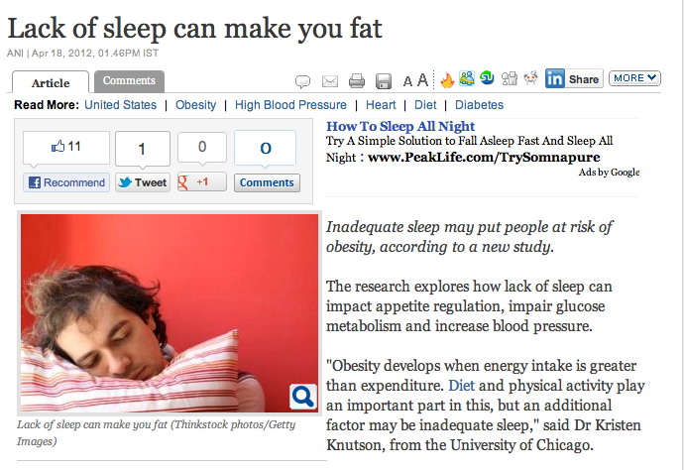
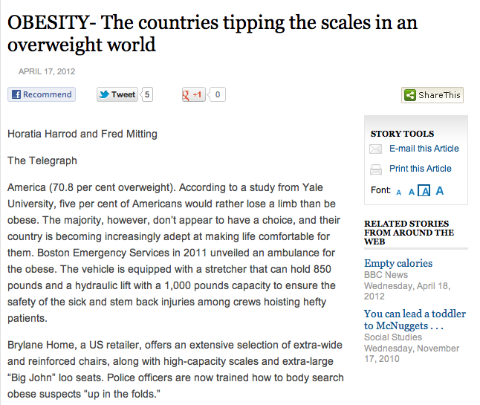
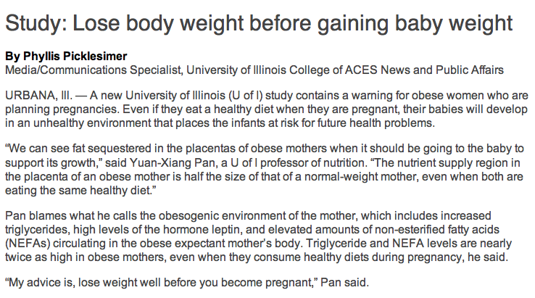
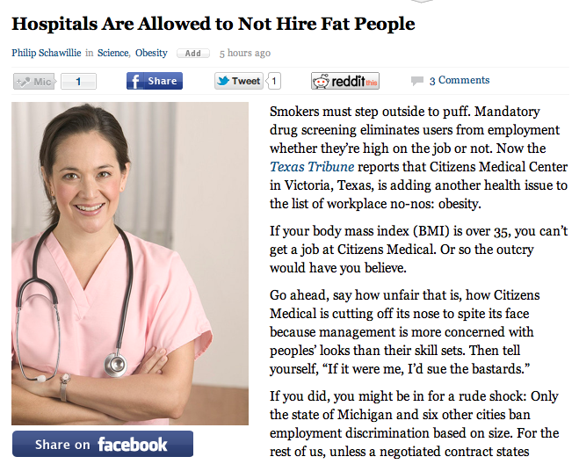
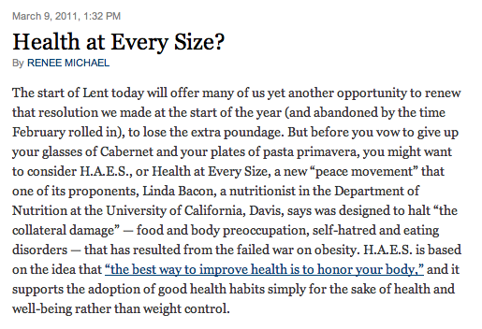
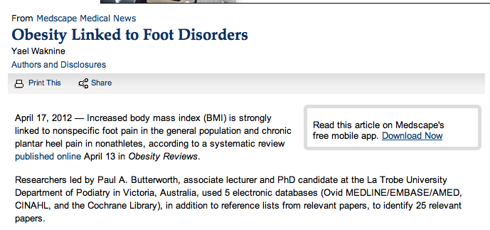
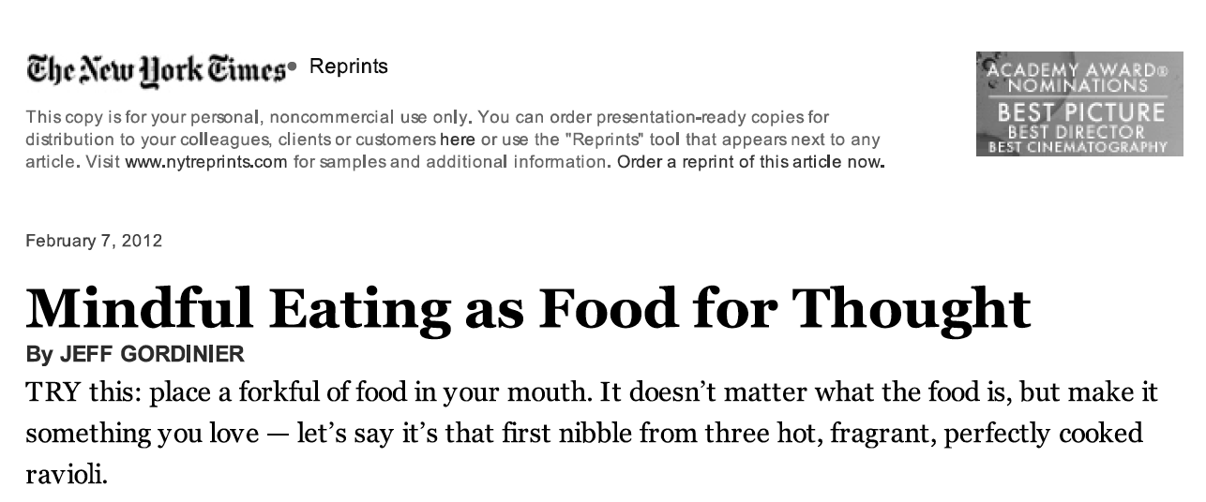
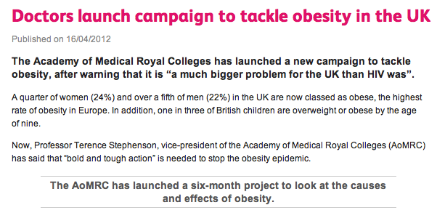
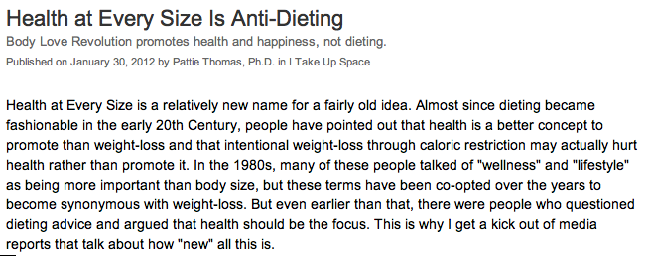
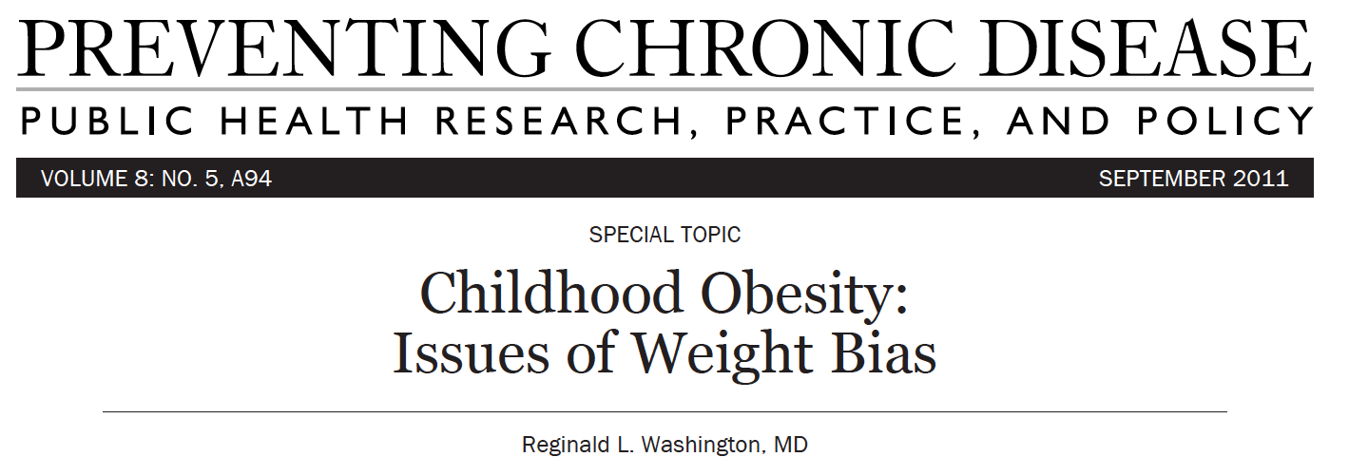
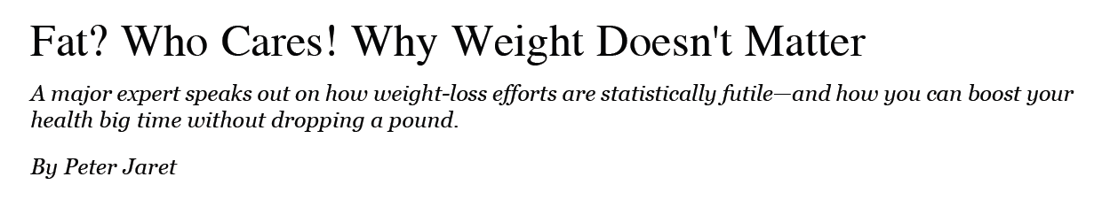
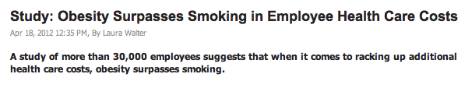
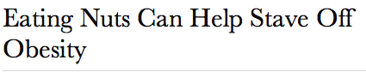
Confused? You’re Not Alone!
CONFLICT

Slide 62
The Point of this Class
“When things are commonly accepted, we don’t see the bias.”
-Linda Bacon
“The first step to fight an ideology is to see it.”

